Slide 1
GUI input and output

Slide 2
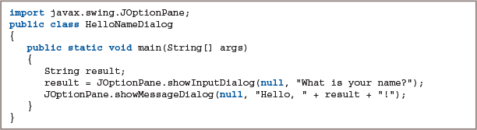
2.7 Using the JOptionPane Class to Accept GUI Input (1 of 6)
Input dialog box
InputDialog
Asks a question
Provides a text field in which the user can enter a response
Figure 2-27: The HelloNameDialog class

Slide 3
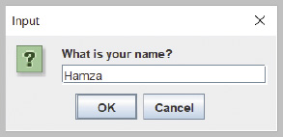
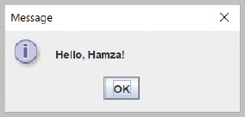
2.7 Using the JOptionPane Class to Accept GUI Input (2 of 6)
Figure 2-28: Input dialog box of the HelloNameDialog application
Figure 2-29: Output of the HelloNameDialog application

